Slide 1
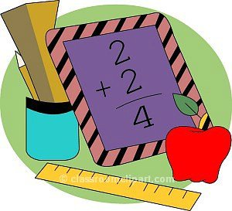
Maths at Warwick Bridge School

Slide 2
Think of a number
Double it
Add on 10
Half it
Take away the number you first thought of
The answer is
5

Slide 3

How parents can help with Mathematics

Slide 4
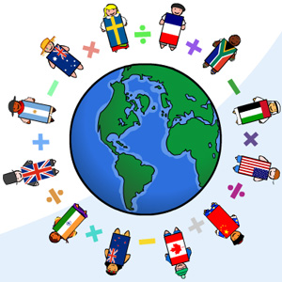
Remember -
You are not expected to teach your child maths, but please share, talk and listen to your child.

Slide 5
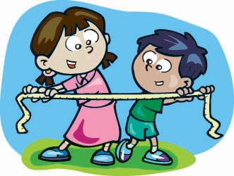
It is most important that you talk & listen to your child about their work in mathematics. It will help your child if they have to explain to you.

Slide 6
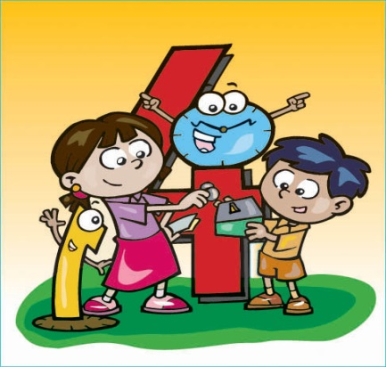
Share the maths activity with your child and discuss it with them. Try to make sure that you have seen the school’s policy and understand how calculations are being taught and what mathematical language is being used in school.

Slide 7
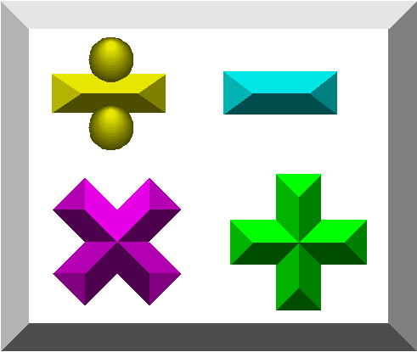
Be positive about maths, even if you don’t feel confident about it yourself.
Play games and have fun with maths!

Slide 8
Play games like dominoes, snakes and ladders, darts, ludo, cribbage, card games (pontoon, snap, rummy, patience, whist) – any activity that reinforces number recognition, matching, counting and calculating. Board games can be extended by using two dice and adding, subtracting, multiplying or dividing.
Help your child to learn how to tell the time on both analogue and digital clocks.
Time your child doing various activities. E.g. How many hops/jumps in a minute? How long it takes to count to 100 in fives.
Talk about weight and capacity when shopping and baking.
Let you child pay for items and check the change when shopping or play ‘shops’ at home.
When out look at shapes in buildings, road signs, etc.

Slide 9
Use car number plates to add the digits and find the biggest/smallest total.
Share sweets, etc.
Sort clothes for washing – size, colour, etc.
Match pairs of socks, gloves, shoes.
Sort groceries.
Look at fractions when cutting pizzas, cakes, sandwiches.
When laying the table ask, ‘How many knives, forks and spoons will I need altogether?
Be positive about maths, even if you don’t feel confident about it yourself.
Play games and have fun with Maths!

Slide 10
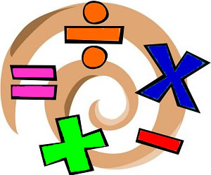
Enjoy Maths – it is fun!

